Slide 1
Smart LPG Gas System using IoT

Slide 2

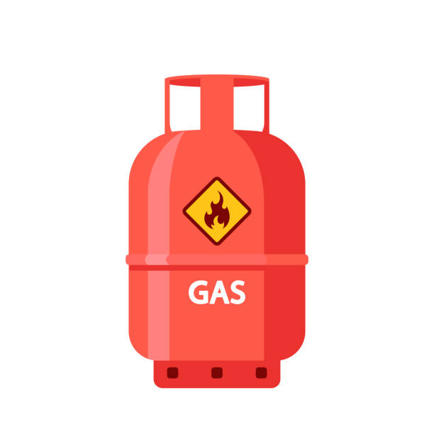
Introduction
A project aims to detect gas leakage of LPG cylinders in Indian homes. LPG is commonly used in homes and is a popular fuel in the country. The project uses the MQ6 LPG gas sensor to detect the level of gas in the cylinder. Also it turn off regualator when gas leakage is decteted.

Slide 3
Literature Survey
.
SR NO | Topic | Author | Details
1 | LPG Leakage Detection and Smart Gas Booking System | Purva Duggal, Akshay Pawar, Poorva Kalkatte, Prof. Rushikesh Bhalerao (2020) | Usage of MQ-5 gas sensor to detect the LPG leakage. Continuous monitoring of the level of LPG present in the cylinder.
2 | LPG/CNG Gas Leakage Detection System with GSM Module | Alan M John, Bhavesh Purbia (2020) | The system detects the leakage of LPG using a gas sensor and uses GSM to alert the user via SMS to the programmed number.

Slide 4
3 | Automated Unified System for LPG using Load Sensor | Gokula kaveeya S, Gomathi S, Kavipriya K, Kalai selvi A, Sivakumar S (2020) | The leakage is sensed through the MQ5 sensor and the load cell measures the gas threshold level and booking are automatically done when the threshold drops to 20%.
4 | LPG leakage detection using IoT | Prof. Dr Chetana Tukkoji Prof. Sanjeev Kumar A N | LPG leakage is classified into three categories, LOW, MEDIUM & HIGH based on the square measure. This paper conjointly shows the ratio and temperature.

Slide 5
Problem Statement
To identify the level , leakage of LPG (Liquid Petroleum Gas) gas and it alert the user for booking the LPG cylinder also turn off the regulator when leakage is detected using IOT.

Slide 6

Objectives/Goals
Develop a robust and user-friendly smart LPG gas system that utilizes IoT (Internet of Things) technology to provide real-time monitoring and control of LPG gas levels.
2. Incorporate safety features, such as leak detection and automatic shutoff, to enhance the overall safety of the LPG gas system.

Slide 7



Requirement Analysis
Hardware Components
Software Requirements
User Interface Design
Develop a user-friendly interface, either mobile app or web-based, to provide real-time monitoring and control of the LPG gas system for consumers.
Identify the necessary hardware components, such as IoT sensors, microcontrollers, and communication modules, to build the smart LPG gas system.
Determine the software and programming languages needed to develop the IoT-based monitoring and control system, including cloud platforms and data analytics tools.

Slide 8
Methodology
In our project we will use an Arduino microcontroller detector system to sense the gas with the help of a sensor.
In which the MQ5 sensor used in this system interfacing with Arduino is implemented in this project
The signal from the sensor is sent to the microcontroller which is connected to communicate with the LCD, send a signal to the buzzer to sound an alarm when there is leakage and also send a message.

Slide 9
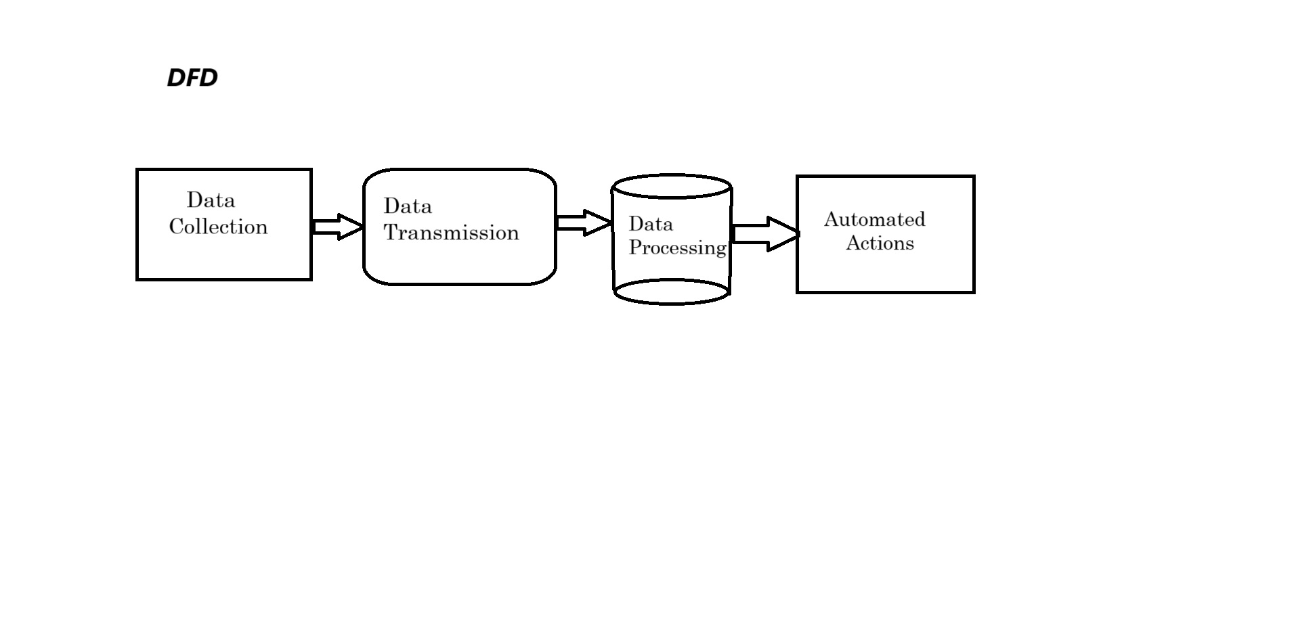





Data Flow Diagram
Data Collection
Data Transmission
Data Processing
Automated Actions
Sensors gather real-time data on gas levels, usage patterns, and safety parameters.
The IoT platform processes the data, applies analytics, and generates actionable insights.
The collected data is securely transmitted to the IoT platform via wireless or wired communication channels.
The platform triggers automated responses, such as refill scheduling and safety alerts, based on the processed data.

Slide 10
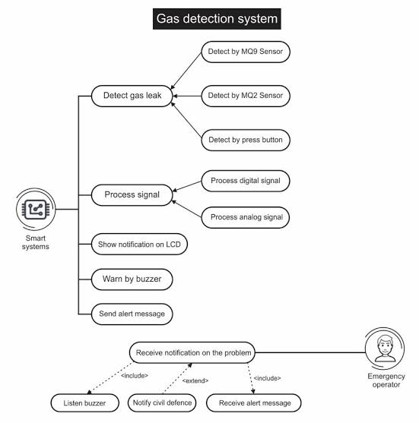
Use Case Diagram
.
.

Slide 11
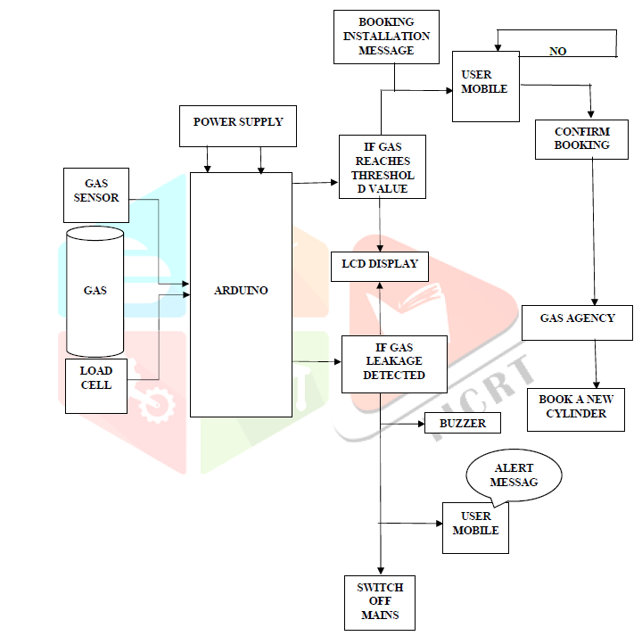
Architectural Diagram

Slide 12
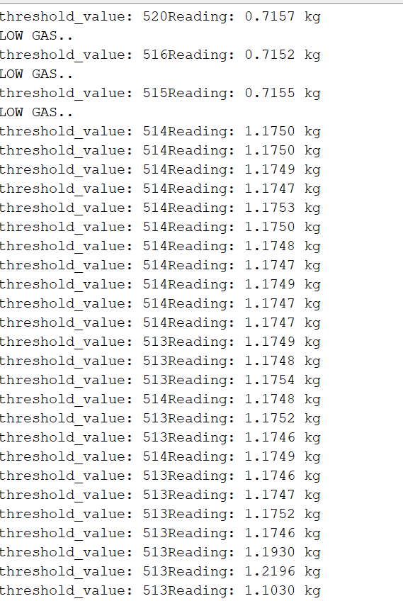
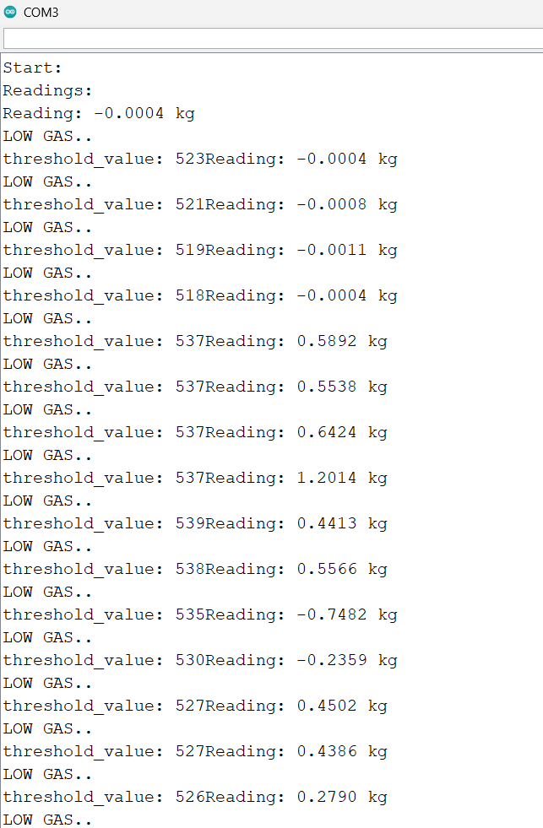
Some Screenshot of Implement

Slide 13
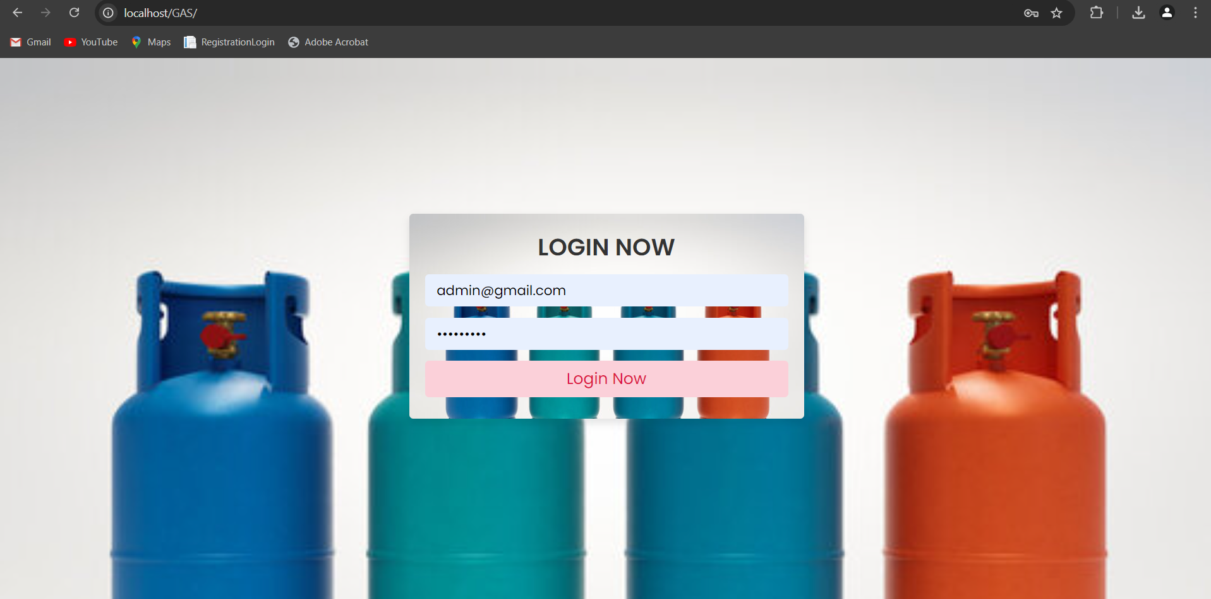

Slide 14
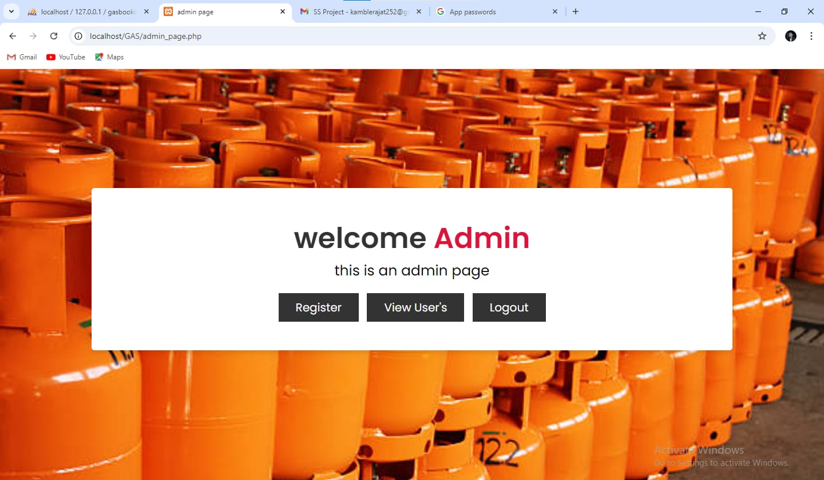

Slide 15
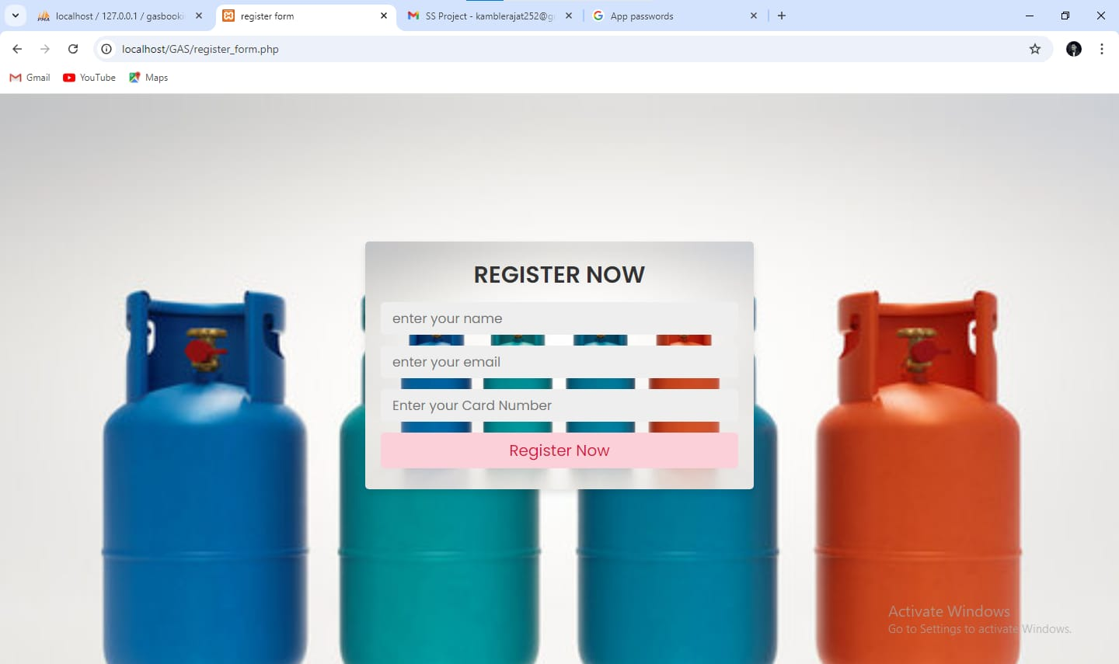

Slide 16
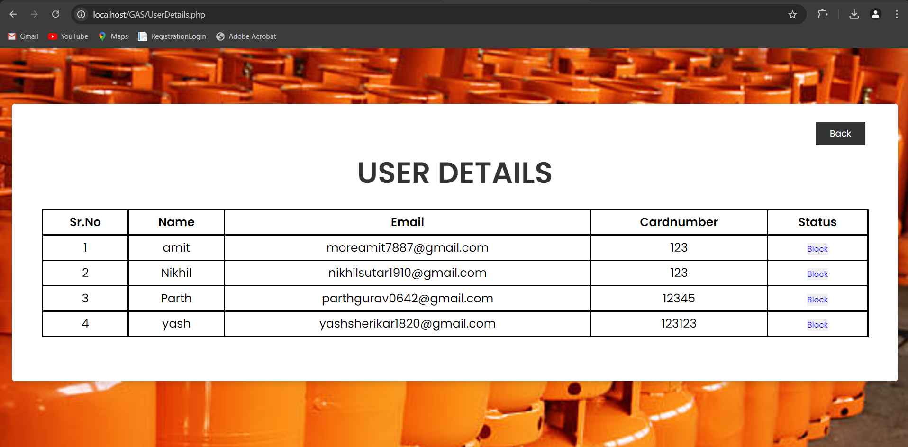

Slide 17
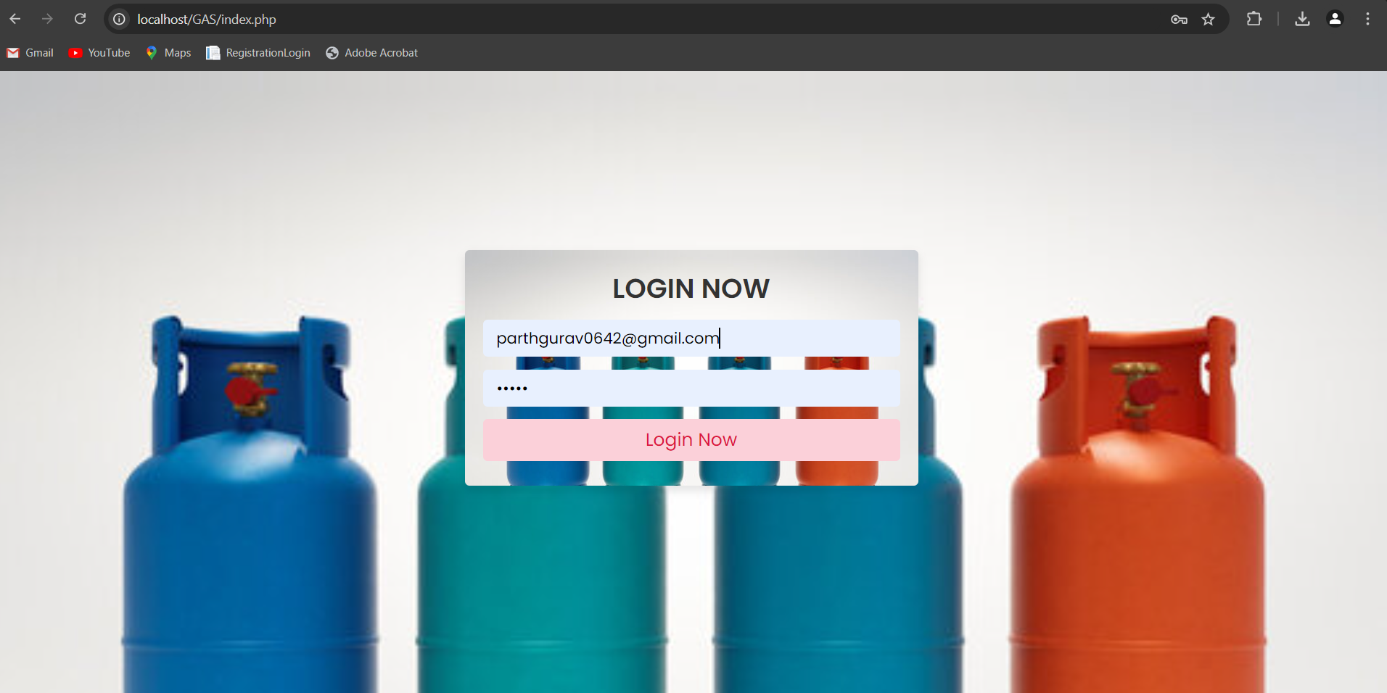

Slide 18
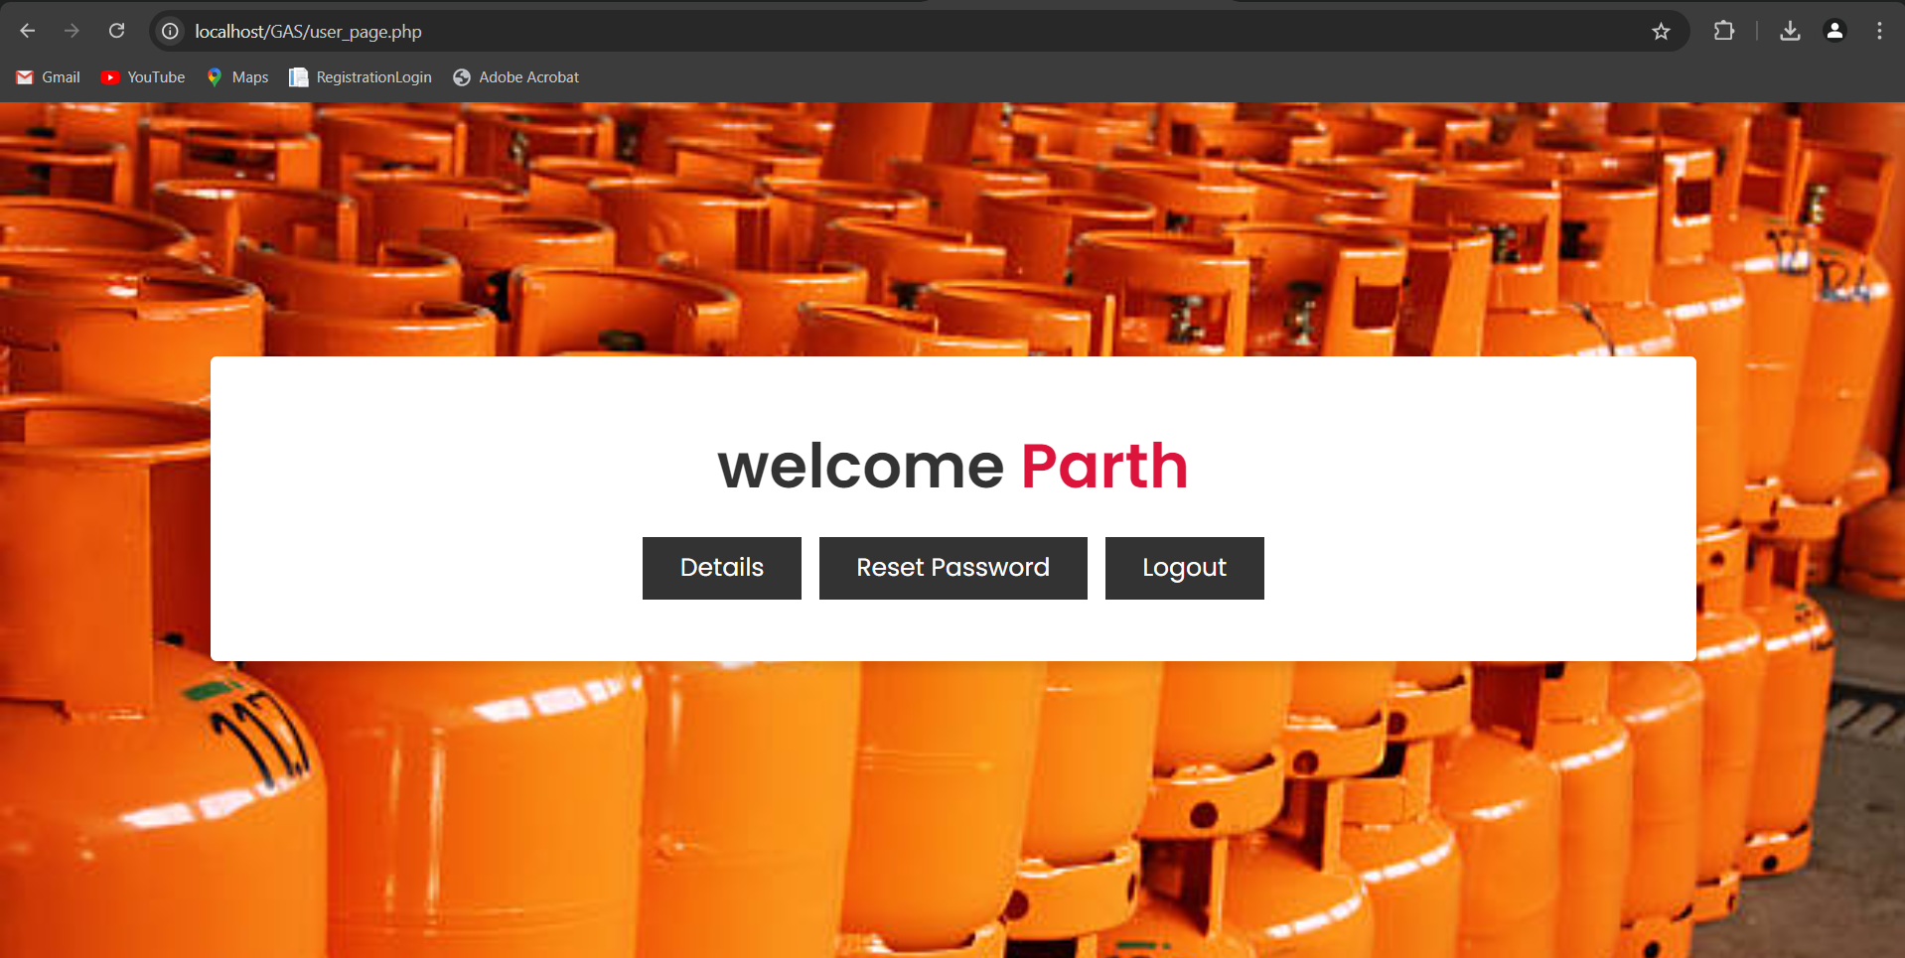

Slide 19
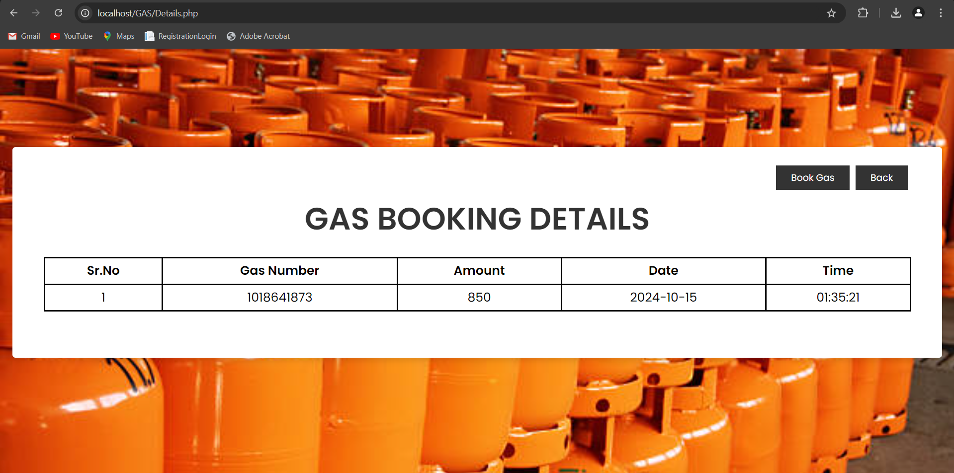

Slide 20
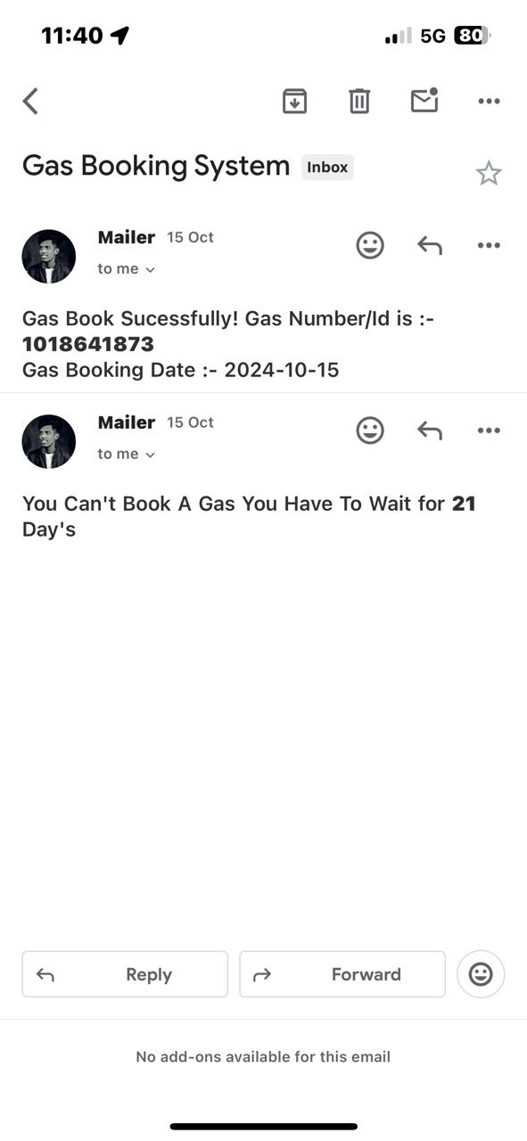
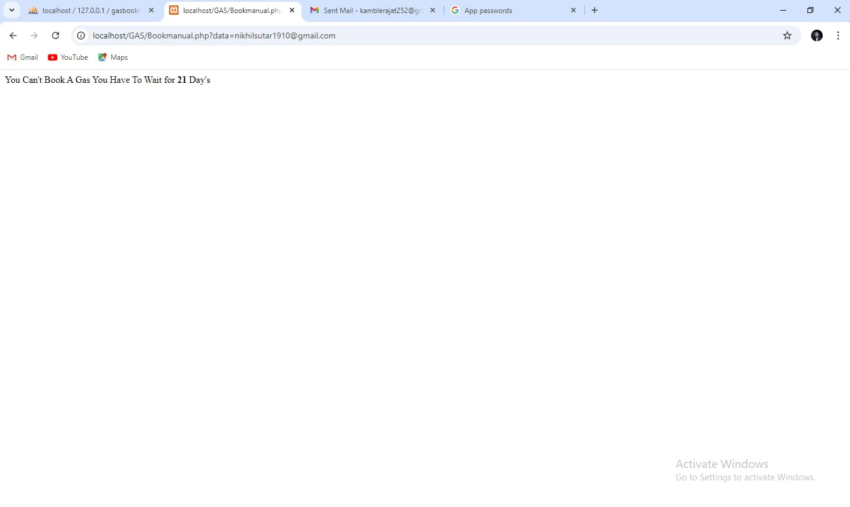

Slide 21
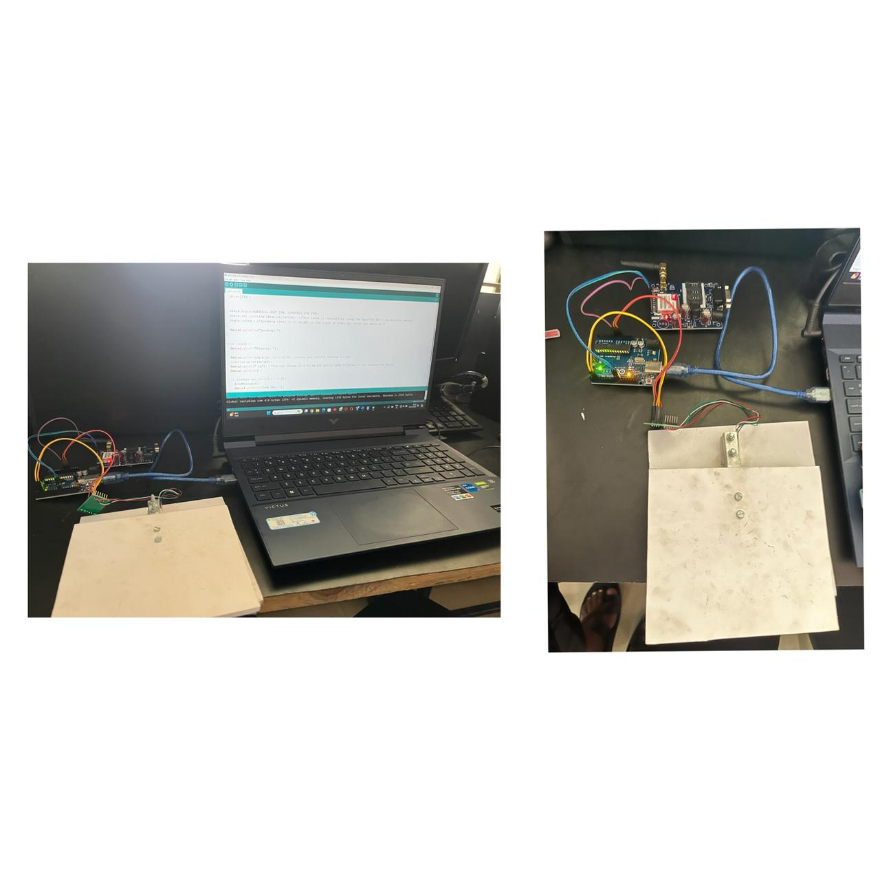

Slide 22
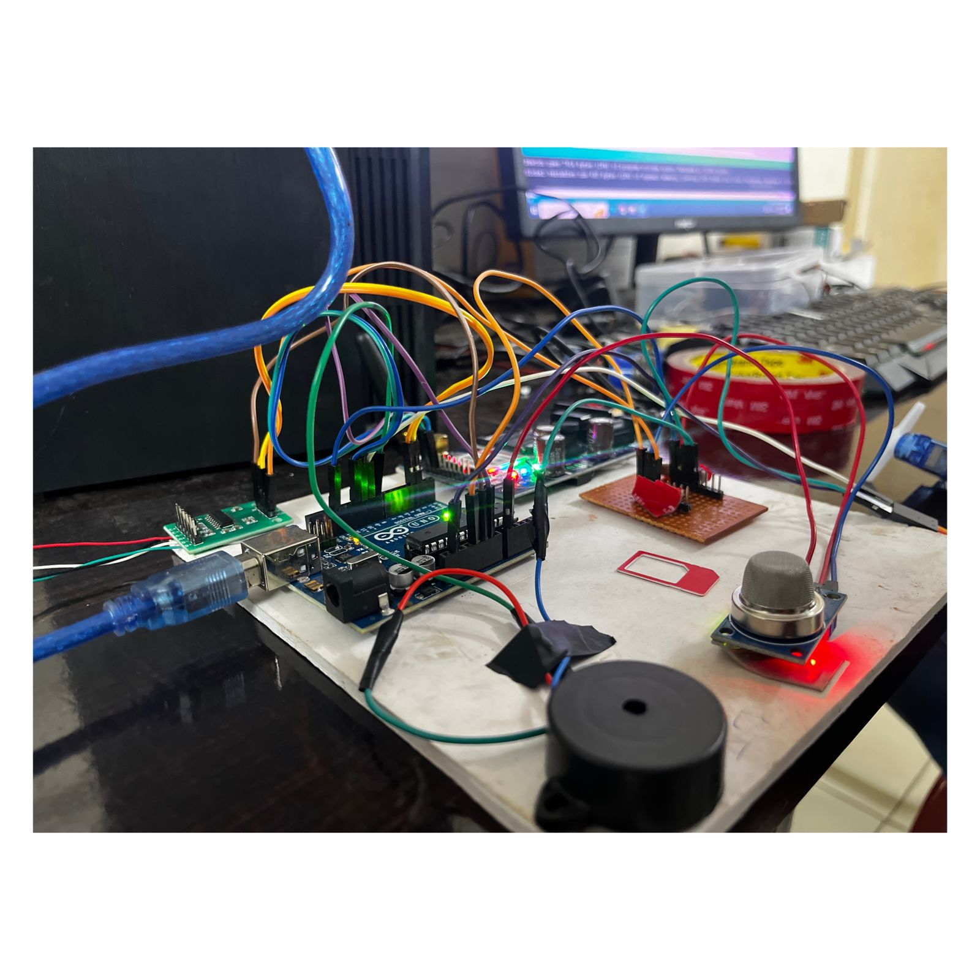

Slide 23
Conclusion
Implementing a smart gas LPG system offers a multitude of benefits, enhancing both safety and convenience for consumers and providers alike. Through advanced monitoring and automation technologies, such a system ensures efficient gas usage, reduces wastage, and minimizes the risk of accidents. Additionally, the integration of smart features facilitates seamless user interaction, empowering consumers with greater control and insight into their gas consumption patterns. Ultimately, the adoption of a smart gas LPG system represents a significant step towards modernizing infrastructure, promoting sustainability, and improving overall quality of life.

Slide 24



Future Scope
Voice Control
Integration with voice assistants for hands-free control and management of the gas system.
Predictive Analytics
Advanced algorithms to predict gas usage patterns and optimize refill scheduling.
Smart Home Integration
Seamless integration with other smart home devices for a truly connected living experience.

Slide 25
References
https://youtu.be/MJH2JY_ytdk?si=7fbOcciJli6fg9nj
https://youtu.be/wC_nH75Wiqg?si=5pFnNyW8yW06g0ag
https://www.renesas.com/en/applications/industrial/building-automation/smart-home-lpg-cylinder-monitor

Slide 26
Thanks
Thank you for your interest in our Smart LPG Gas System powered by IoT technology. We hope this presentation has provided you with a comprehensive understanding of the system's features and capabilities.

